Slide 1
RECORDS PROCESS AND PROCEDURES

Slide 2
OBJECTIVES
Consistent records process and procedure
Facilitating storage of permanent records and archives between sites and warehouse
Maintaining a records database for easier request to locate records
Uniformed Box Number Sequence
Updated Archive Log
Inconsistencies found during the State Records Audit

Slide 3
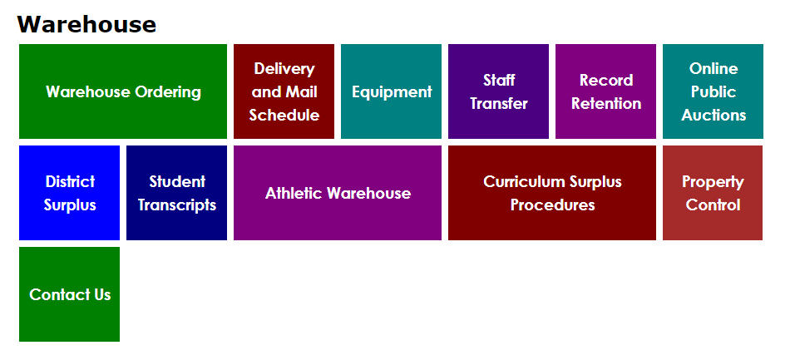
Where to find archive information
Our warehouse website on CUSD80.com has information and links directed to
AZ State Library, Archives & Public Records Retention Schedules website.
Go to CUSD80.com. There you will find a Departments tab. In departments
Directory, click the Warehouse Link. This will take you to our Warehouse webpage.

Slide 4
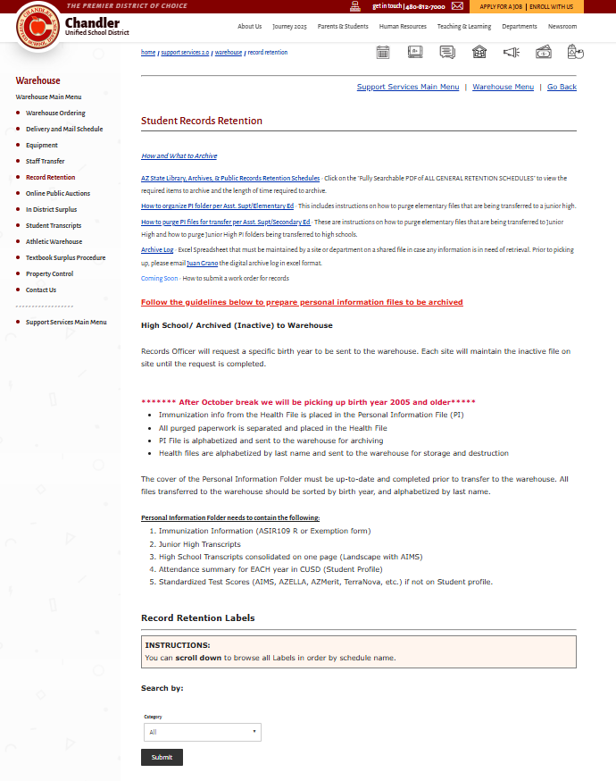

Slide 5
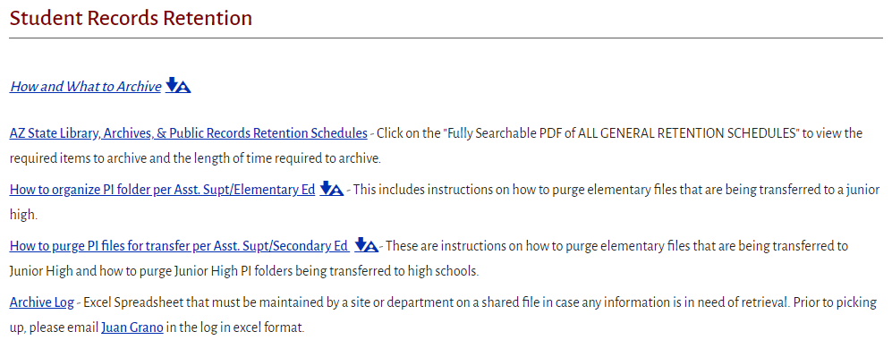
Where to find archive information
Clicking the Record Retention button will take you to the Student Records Retention page
https://azlibrary.gov/arm/retention-schedules
Here you will find important information on permanent records, archiving and updated
links on “How to organize PI Folders for Elementary and Secondary Ed”.

Slide 6
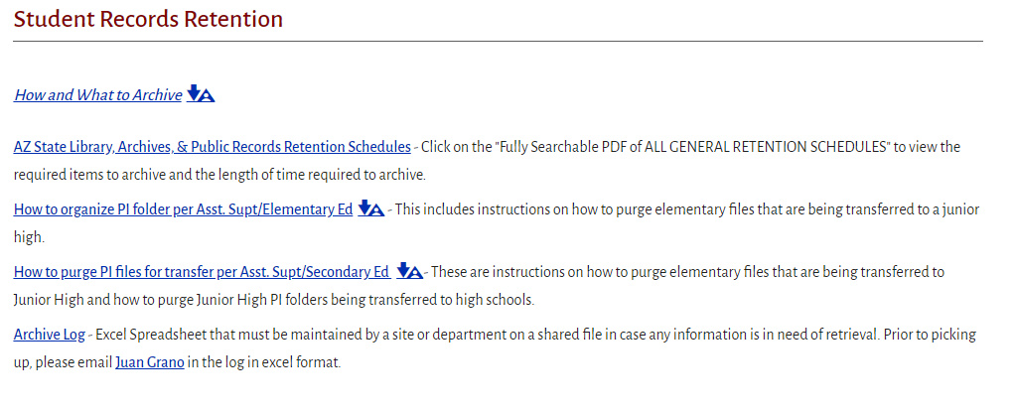
What To Archive
Refer to the following links found on the Student Records Retention.
For questions regarding how to organize student files please contact
Autumn Sample X.7612
Joanna Athey X.7667

Slide 7
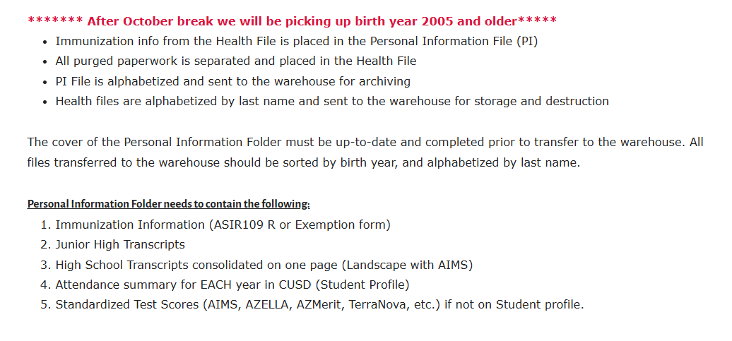
What To Archive
The student records retention page includes information on what personal information
files should contain when creating the permanent file.

Slide 8
Archive Log
An updated archive log is now active. During this last reporting period, it was found that the
previous archive log was an older version that did not coincide with the Certificate of Records
Destruction form.
Old Version
The old version also caused duplicate box numbers, that created inefficiencies when locating
records requests.

Slide 9
Archive Log
The update version will allow us to be more efficient when locating records requests and state reporting for destruction of records.
Updated Archive Log
The updated log now includes a records start date column and records end date column. The shred year is now called eligible to destroy date.

Slide 10
Archive Log
Work Order #: The W/O# is generated by Incident IQ. Your site admin will provide you with this number when the W/O is submitted.
Site or Dept: Abbreviated School or Department Name
Box Number: Current school year/site number/box number (24-202-1). Recommend the box number start over at the start of new school year
Records Series Title: Submit the exact series title description found in the Retention Schedule Database.
Schedule Number: General Retention Schedule Number
Records Series Number: Submit the exact series title number found in the Retention Schedule Database.
Records Start Date: Enter the earliest date of records you are requesting to destroy under the Records Start Date column
Records End Date: Enter the latest date for the records you are requesting to destroy under the Records End Date column
Eligible to Destroy Date: Enter the date the records were eligible for destruction
Comment: Contents of boxes

Slide 11
Updated Archive Log
Processed Archive Log
WO # | SITE NAME | BOX NUMBER | RECORDS SERIES TITLE | SCHEDULE NUMBER | RECORDS SERIES NUMBER | RECORDS START DATE | RECORDS END DATE | ELIGIBLE TO DESTROY DATE | COMMENT
PERM | CHS | 24-202-1 | STUDENT RECORDS: PEMANENT | GS-1074 | 21194 | 07/1/2023 | 6/30/2024 | PERMANENT
PERM | CHS | 24-202-2 | STUDENT RECORDS: PEMANENT | GS-1074 | 21175 | 7/1/2023 | 6/30/2024 | 2026
2026H | CHS | 24-202-5 | STUDENT WITHRAWAL NOTICES | GS-1074 | 21175 | 7/1/2023 | 6/30/2024 | 2028
2027D | CHS | 24-202-3 | STUDENT RECORDS: ACTIVITIES | GS-1074 | 21175 | 7/1/2023 | 6/30/2024 | 2028
2027D | CHS | 24-202-4 | STUDENT RECORDS: ACTIVITIES | GS-1074 | 21175 | 7/1/2023 | 6/30/2024 | 2028

Slide 12
Request to Pickup files and Archive Log Submission
After your archive log has been updated, submit a work order in Incident IQ. A link on How to Submit a Work Order Ticket for Records, Archives and Permanent Records has been added to the records retention webpage. Or you can find the link here (CUSD Warehouse Tickets In Incident IQ) for step-by-step instructions.
Once the work order is received, the warehouse team will schedule a pickup.
Ensure your archive log is fully completed and attached before submitting the work order

Slide 13
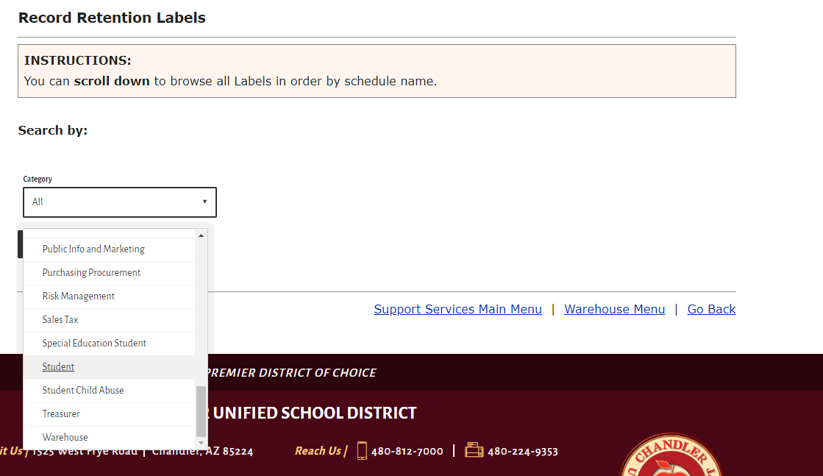
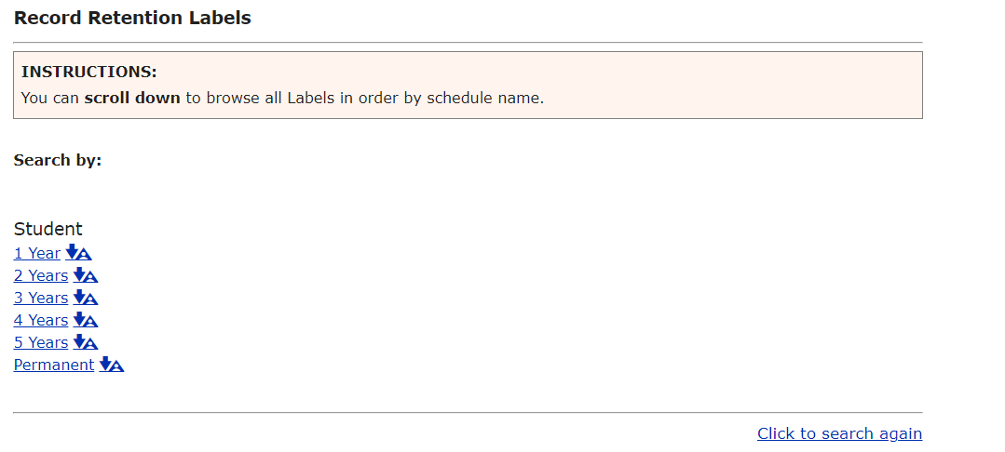
Record Retention Labels
Student Records

Slide 14
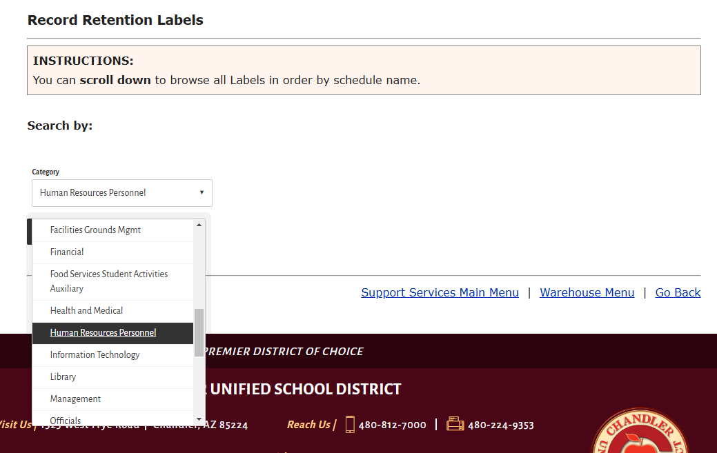
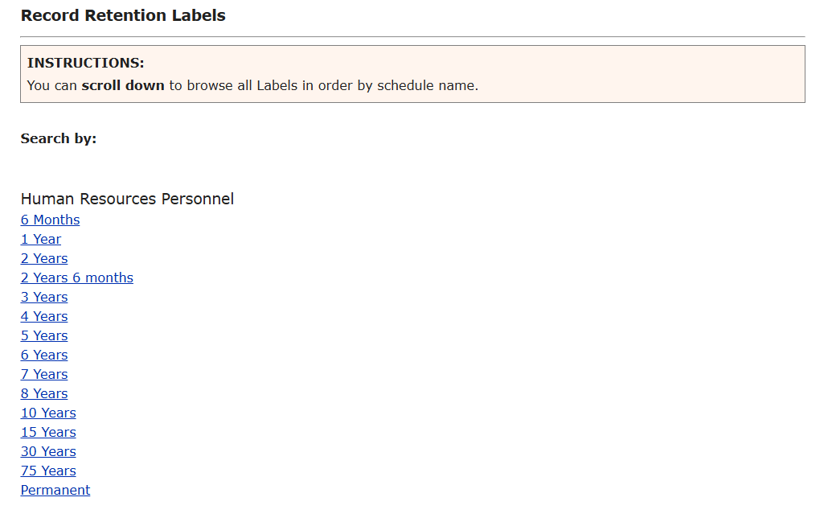
Record Retention Labels
Non-Student Records

Slide 15
Record Retention Labels
This section includes Record Retention Label templates used to label permanent
and retention period records.
Please attach labels to the short side of the box. Archive boxes are required to have
2 labels per box. Front and back.
Use the label template that coincides with the retention period assigned to the record
Permanent records use orange labels (2 labels per sheet)
Retention period records use yellow labels (2 labels per sheet)
Both colored labels are available at the warehouse at no cost.
To request labels, send an email to Juan Grano at grano.juan@cusd.com

Slide 16
Requesting Records
When requesting records, contact Eloise Cary at CARY.ELOISE@CUSD80.COM and Juan Grano at
GRANO.JUAN@CUSD80.COM
Include Student Name, Birth year, Grad Year, box number and specific file (Perm or Non-perm)
All other records, include Site Name, Department and Box Number
Lead times for records are 3 to 5 business days (includes inter-office mail lead time)
Large audits records request can be a 2-week lead time.
Records request at the warehouse are by appointment only. Warehouse needs to have the appropriate
staff to help.
Warehouse request that all visitors wear proper shoes when helping with locating files. Tennis shoes
or closed toe shoes.

Slide 17
Questions
Please email questions to
Juan Grano and Eloise Cary.

